Slide 1
Special orbits types
Polar orbit
Repeat orbit
Sun Synchronous orbit
Frozen orbit

Slide 2
Special orbits types
Polar orbit
Provides maximum coverage
Can not provide continuous view of an area

Slide 3
Special orbits types
Repeat orbit
Allows an area to be viewed more than once.
Assuming a footprint size of 100 meters:
40.000.000/(2*100)=200.000 revolutions
200.000*90 (minutes) = 34 years

Slide 4
Special orbits types
Sun synchronous orbit
Orbital plane fixed w.r.t. the sun vector
Most useful orbit is the dawn/dusk orbit
  Solar panels are in the sunlight continuously
  Allows pointing to the night side of the Earth

Slide 5
Special orbits types
Frozen orbit
Reduces the need for orbit station keeping.
A constellation in formation flight has strict constraints.
  A frozen orbit helps meet these constraints

Slide 6
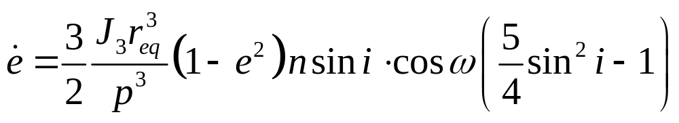
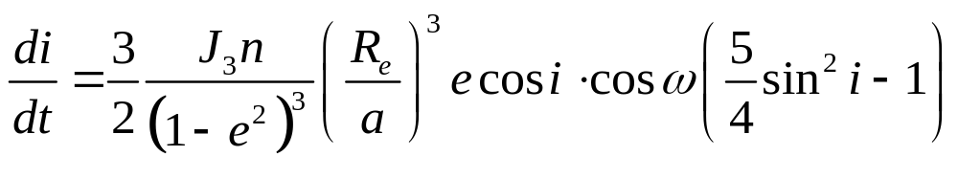
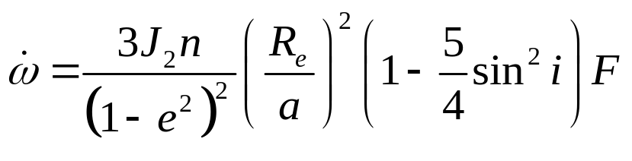
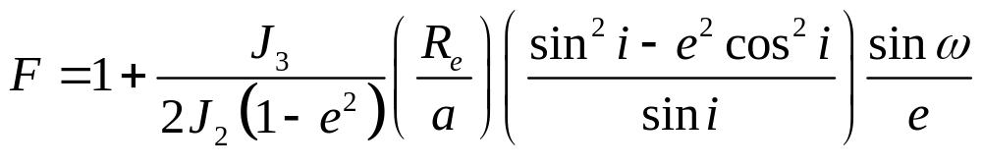
Special orbits types
Frozen orbit design equations

Slide 7
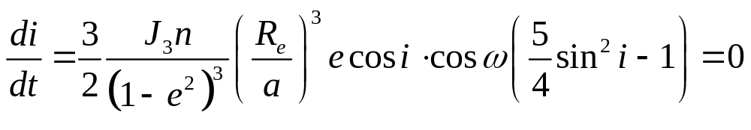
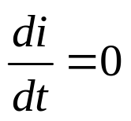
Special orbits types
Frozen orbit design equations
Circular orbit, so e = 0
for any a, i or ω

Slide 8
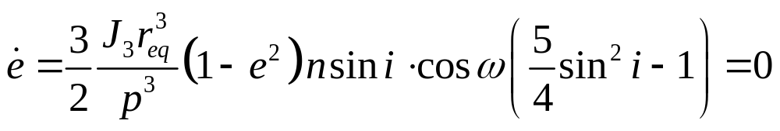
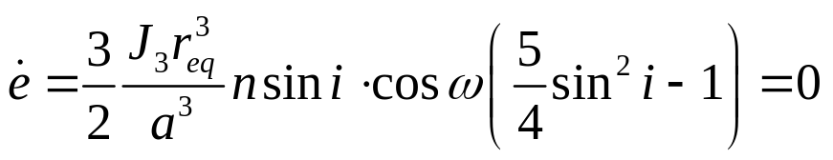
Special orbits types
Frozen orbit design equations
With e = 0 this becomes
Equation is satisfied for any a and i if ω = 90 degrees

Slide 9
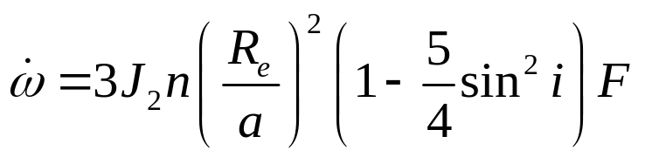

Special orbits types
Frozen orbit design equations
With e = 0 these equations reduce to

Slide 10
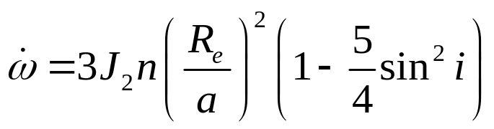

Special orbits types
Frozen orbit
Is equal to zero if i = 63.4 OR i = 116.6 degrees
However a polar orbit is an orbit of 90 degrees inclination
  Definition: An orbit is a polar orbit if degrees

Slide 11
Special orbits types
Frozen orbit
The orbit is circular
  It does not matter if ω rotates in the orbit plane
Taking collision avoidance into collision avoidance
  i = 85 degrees

Slide 12
Special orbits types
Summary
Sun synchronous is not required
Repeat orbit is unfeasible
The end result is a
Frozen, polar orbit with
      e = 0 degrees
      i = 90 degrees
      ω = 90 degrees

